Slide 1



Sign Language Detection System
Adison Giri (382485)
Hawana Tamang (382491)
Sama Nemkul Shrestha (382506)

Slide 2


Highlight daily communication challenges faced by millions
Identify limitations of traditional sign language interpreters
Motivation:
Addressing Communication Barriers
Millions of people experience daily difficulties in communication due to hearing or speech disabilities, impacting their social interactions and access to information.
Traditional sign language interpreters are often unavailable or costly, creating barriers to effective communication and limiting inclusivity in many settings.
Promote AI-powered real-time gesture recognition as a solution
Emphasize accessibility and bridging communication gaps
AI-driven gesture recognition technology provides an inclusive assistive solution that translates sign language in real time, empowering users and facilitating seamless communication.
This innovative technology promotes accessibility and helps bridge communication gaps in everyday interactions, fostering social inclusion and empowerment for individuals with disabilities.

Slide 3

Develop a real-time CNN -based sign recognition system
Project Objectives
and Scope
Create a robust convolutional neural network capable of accurately classifying sign language gestures instantaneously to empower communication.
Enable webcam-based gesture detection with Streamlit interface
Implement a user-friendly interface using Streamlit that allows real-time gesture recognition via webcam for accessible interaction.
Evaluate system performance on standard and real-world data
Test and validate the system using both a standard dataset and custom real-world images to ensure reliability and practical usability.
Establish foundation for dynamic gesture and phrase recognition
Lay groundwork for future enhancements to support recognition of dynamic gestures and complex sign language phrases, expanding communication possibilities.

Slide 4


Dataset Overview: Scale and Balance
Image Distribution Across Dataset Splits.

Slide 5






Data Preprocessing Pipelines
OpenCV preprocesses webcam video
Resize images to 64×64 pixels
Standardizes image dimensions for consistent model input.
Handles real-time video input to ensure smooth and accurate data capture.
Extraction
Preprocess
Normalize
Resize
Augmentation
MediaPipe extracts 21 hand landmarks
Normalize images to 0,1 scale
Apply data augmentation
Scales pixel values uniformly to improve model training stability.
Provides precise gesture representation by identifying key hand points.
Uses rotation, flipping, and scaling to enhance model generalization.

Slide 6
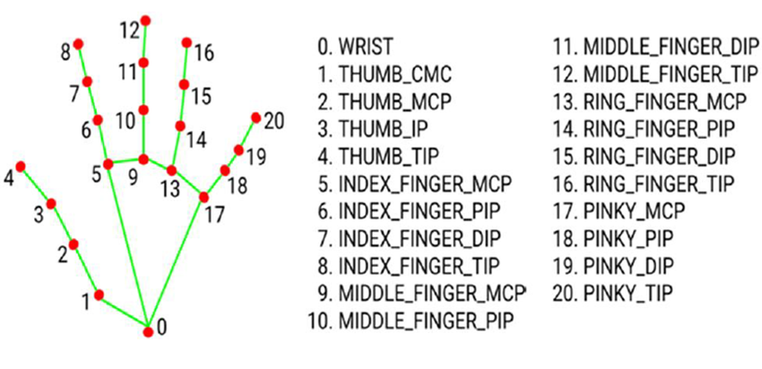
Hand Landmarks

Slide 7


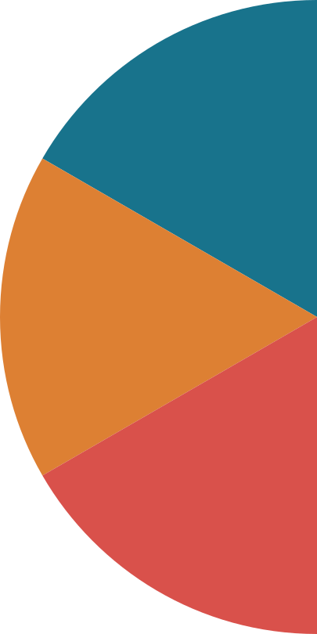







System Architecture and Workflow
1
4
Input
CNN Model
Webcam captures hand gestures
Convolution + Pooling + Dense layers
2
5
Flow
Preprocessing
Classification
Landmark extraction & normalization
Softmax → Predicts Alphabets
3
6
Data Augmentation
Frontend
Improve generalization (rotation, flipping, scaling)
Streamlit UI displayes results

Slide 8
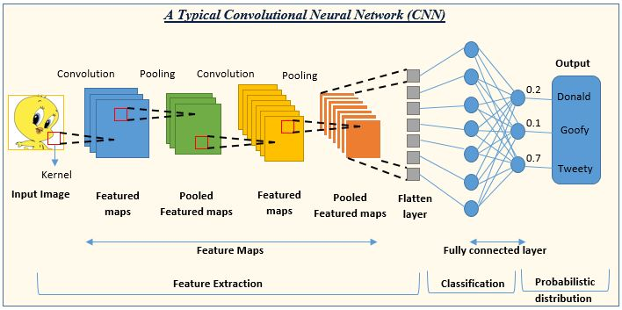
CNN Model

Slide 9







__________________________________________
CNN MODEL ARCHITECTURE
Input: 64×64 RGB images
Dense layers followed by Softmax output
Images with 3 color channels serve as the model's input for processing sign language gestures.
Fully connected layers classify into 26 classes (A-Z) with Softmax for probability distribution.
Four Conv2D layers with ReLU activation
Flatten layer connects to dense layers
MaxPooling layers reduce spatial dimensions
Convolutional layers extract meaningful features from images using ReLU to introduce non-linearity.
Transforms multi-dimensional convolutional output into a one-dimensional vector for classification.
Pooling layers downs ample feature maps to lower computational load and emphasize important features.

Slide 10
Training Evaluation & Performance Metrics
69,600 images
17,400 images
Extensive training dataset ensures model robustness
Comprehensive validation for optimal model tuning
A large training set of 69,600 images builds a strong foundation for the model, enabling effective learning and improved accuracy over diverse sign language gestures.
Validation on 17,400 images allows precise hyperparameter tuning and prevents overfitting, enhancing real-world applicability and reliability.
100% accuracy
Optional extended metrics
Flawless performance signals strong generalization
Multi-dimensional evaluation enhances trustworthiness
Achieving 100% test accuracy confirms the model's capability to generalize well beyond training data, ensuring consistent performance in diverse environments.
Utilizing confusion matrix, precision, recall, and F1-score provides deeper insights into model behavior, supporting transparency and continuous improvement.

Slide 11








Real Time Demonstration & Observations
Achieve hand gesture prediction with under 100ms latency
Deliver smooth, responsive UI using Streamlit
Maintain robustness against hand rotations, lighting, and occlusions
Utilize MediaPipe preprocessing to reduce complexity and boost efficiency
Employ CNN to distinguish subtle gesture differences effectively
The model processes gestures quickly, ensuring real-time responsiveness suitable for live assistive applications.
The user interface is designed for seamless interaction, enhancing user experience during live gesture detection.
The convolutional neural network accurately differentiates fine variations in hand gestures, critical for sign language recognition.
The system reliably recognizes gestures despite minor variations and challenges in the environment.
Preprocesing simplifies the input data for the CNN, improving model performance and speed.

Slide 12
Thankyou

